Slide 1
What is EIA?
Environmental impact assessment is a process of identifying, predicting, evaluating, and mitigating the biophysical, social, and other relevant effects of proposed projects and physical activities prior to major decisions and commitments being made .”

Slide 2
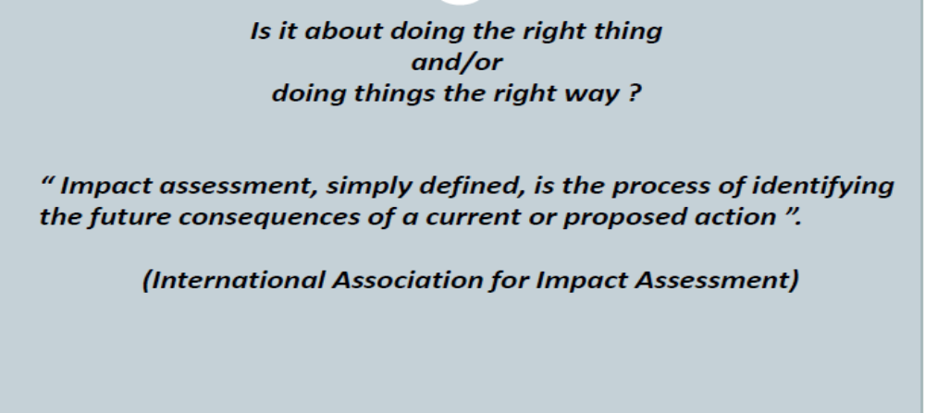
What is EIA?

Slide 3
What is EIA?
Environmental
Impact Assessment is
✓
A formal process for identifying:
  likely effects of activities or projects on the ENVIRONMENT, and on human health and welfare.
  means and measures to mitigate & monitor these impacts
Environment is broadly interpreted: physical, biological, and social.
In EIA, the term “impacts” is used instead of “effects of activities.”
What is an impact?
Notes:
Aspects of the environment:
Physical: soil & water resources, air quality
Biological: fauna, flora, ecosystem
Social: human health and welfare, culture, religion, and local values
Or: Economical, social and eco-systemic

Slide 4
What is an impact?
The impact of an activity is a deviation (a change) from the baseline situation that is caused by the activity.
The baseline situation is the existing environmental situation or condition in the absence of the activity.
The baseline situation is a key concept in EIA.
!
To measure an impact, you must know what the baseline situation is.
More…

Slide 5
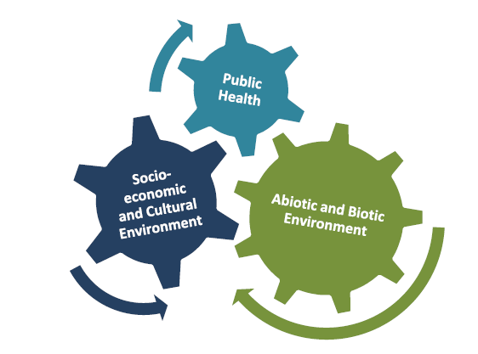
Impact Areas

Slide 6
The baseline situation
Water Quantity, quality, dependability, accessibility
In characterizing the baseline situation, many environmental components MAY be of interest
Soils Erosion, crop productivity, fallow periods, salinity, nutrient concentrations
Fauna Populations, habitat
The components of interest are those that are likely to be affected by your activity—or upon which your activity depends for its success
Env Health Disease vectors, pathogens
Flora Composition and density of natural vegetation, productivity, key species
Special Key species
ecosystems
ENCAP EA-ESD Course: Basic Concepts for EIA. Visit www.encapafrica.org
Notes:
For example, an ecotourism activity might depend on water level in watering holes---but this environmental component is not in fact affected by your activity.

Slide 7
Impact statements must contain:
A description of the proposed action,
its purpose,
and the description of the environment affected;
The relationships to land use plans, policies, and controls for the affected areas;
The probable environmental impacts, positive and negative , direct and indirect, and possible international implications;
A discussion of alternatives;
The probable negative impacts that cannot be avoided or mitigated;

Slide 8
The relationship between local and short
term use and long term considerations;
An permanent commitment of resources;
A description of national to mitigate and offset adverse effects, and Comments from reviewers.

Slide 9
Types of impacts & their attributes
Direct & indirect impacts
Short-term & long-term impacts
Adverse & beneficial impacts
Cumulative impacts
The EIA process is concerned with
all types of impacts and may describe them in a number of ways
✵ Intensity
✵ Direction
✵ Spatial extent
✵ Duration
✵ Frequency
✵ Reversibility
✵ Probability
But all impacts are NOT treated equally.
ENCAP EA-ESD Course: Basic Concepts for EIA. Visit www.encapafrica.org

Slide 10
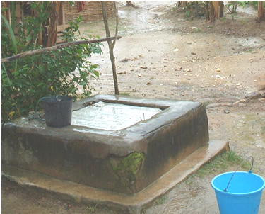
The baseline situation
The baseline situation is not simply a “snapshot.”
Describing the baseline situation requires describing both the normal variability in environmental components & current trends in these components.
Water table
time
This chart of groundwater levels shows both variability and a trend over time.
Both are part of the groundwater baseline situation.

Slide 11
What is an activity?
We are discussing the impacts of activities.
What are activities?
✓
An activity is:
a desired achievement or output
E.g.: a road, seedling production, or river diversion to irrigate land
Accomplishing an activity requires a set of actions
ACTIVITY: market access road rehabilitation | ACTIONS: Survey, grading, culvert construction, compaction, etc. . .
A project or program may consist of many activities

Slide 12
The EIA process
Phase I:
Initial inquiries
Phase II:
Full EIA study
(if needed)
Understand proposed activities
Screen
Conduct preliminary assessment (if needed)
Scope
Evaluate baseline situation
Identify & choose alternatives
Identify and characterize potential impacts of proposed activity and each alternative
Develop mitigation and monitoring
Communicate and document
Our focus!

Slide 13
Phase 1 of the EIA Process
Phase I
Phase II
Understand proposed activity
Why is the activity being proposed?
What is being proposed?
Screen the activity
Based on the nature of the activity what level of environmental review is indicated?
Conduct a Preliminary Assessment
A rapid, simplified EIA study using simple tools
(e.g. the USAID IEE)
ACTIVITY IS
OF MODERATE
OR UNKNOWN
RISK
SIGNIFICANT ADVERSE IMPACTS POSSIBLE
BEGIN FULL EIA STUDY
SIGNIFICANT
ADVERSE
IMPACTS
VERY UNLIKELY
ACTIVITY IS LOW RISK (Of its nature, very unlikely to have significant adverse impacts)
STOP the EIA process
ACTIVITY IS HIGH RISK (Of its nature, likely to have significant adverse impacts)

Slide 14

Phase 1 of the EIA process:
Understand the proposed activity
Understand the proposed activities
Why is the activity being proposed?
What is being proposed?
ALL EIA processes begin with understanding WHAT is being proposed, and WHY.
The question
“WHY IS THE ACTIVITY BEING PROPOSED?
Is answered with the development objective (D.O.).
✗
✓
“building a road”
“increasing access to markets”
Not a D.O.!
Is a D.O.
“If we don’t understand it, we can’t assess it!”
We must understand the
Development Objective to identify
environmentally sound alternatives

Slide 15
Phase 1 of the EIA process:
Understand the proposed activity
Understand the proposed activities
Why is the activity being proposed?
What is being proposed?
Once we understand the development objective, we must fully understand WHAT is being proposed.
This includes associated actions!
PRIMARY ACTIVITY: construction of diversion dam & irrigation canal
ASSOCIATED ACTIONS:
  Survey
  negotiate land tenure
  construct borrow pit
  establish construction camp
  construct temporary diversion structure
  dispose of soil, debris
“Oops. I forgot about the borrow pit.”
Notes:
Note that the difference between ACTIVITIES and ACTIONS is discussed in

Slide 16
Phase 1 of the EIA process:
Screen the activity
Screen each activity
Based on the nature of the activity, what level of environmental analysis is indicated?
SCREENING is the process of asking a very basic set of questions about the nature of activity.
These questions:
  do NOT require analysis.
  do NOT require detailed knowledge about the proposed sites, techniques or methods
Example screening questions: Does the activity involve:
  Penetration road building?
  Large-scale irrigation?
  Introduction of non-native crop or agroforestry species?
ENCAP EA-ESD Course: Basic Concepts for EIA. Visit www.encapafrica.org
Notes:
Are these questions indicative of low-risk or high-risk activities

Slide 17
Phase 1 of the EIA process:
Screen the activity
Screen each activity
Based on the nature of the activity, what level of environmental analysis is indicated?
screening classifies the activity into a RISK CATEGORY:
VERY LOW RISK
EIA process ends
VERY HIGH RISK
Do full EIA study
MODERATE OR UNKNOWN RISK
Do preliminary assessment
The outcome of the screening process determines the next step in the EIA process

Slide 18
Phase 1 of the EIA process:
Screen the activity
!
Each donor agency and national EIA law has its own set of screening questions.
✓
Screening is the topic of an upcoming module

Slide 19
Phase 1 of the EIA process:
The Preliminary Assessment
Conduct a Preliminary Assessment
A rapid, simplified EIA study using simple tools
(e.g. the USAID IEE)
The purpose of a preliminary assessment is to provide documentation and analysis that:
Allows the preparer to determine whether or not significant adverse impacts are likely
Allows the reviewer to agree or disagree with the preparer’s determinations
Sets out mitigation and monitoring for adverse impacts
!
Screening determines whether the preliminary assessment is necessary

Slide 20
Phase 1 of the EIA process:
The Preliminary Assessment
Typical Preliminary Assessment outline
1. Background (Development objective, list of activities)
2. Description of the baseline situation
3. Evaluation of potential environmental impacts
4. Mitigation & monitoring
5. Recommended Findings
For each activity it covers, a preliminary assessment has 3 possible findings:
  The project is very unlikely to have significant adverse impacts. (EIA process ends)
  With specified mitigation and monitoring, the project is unlikely to have significant adverse impacts
  The project is likely to have significant adverse impacts (full EIA study is required)

Slide 21
What is mitigation?
Mitigation is. . .
✓
The implementation of measures designed to reduce the undesirable effects of a proposed action on the environment
Mitigation is the topic of an upcoming module!

Slide 22
To arrive at findings:
Identify, Predict and Judge
Arriving at the FINDINGS in a preliminary assessment requires 3 steps:
1
Identify potential impacts
Many resources describe the potential impacts of typical small-scale activities.
2
Predict potential impacts
Determine which potential impacts are likely to become actual, and quantify these impacts to the extent possible.
3
Judge the significance of potential impacts
Determine whether the predicted impacts are indeed significant!
THIS WILL OFTEN DEPEND ON HOW EFFECTIVE THE PROPOSED MITIGATION MEASURES ARE!
Notes:
Predicting impacts can involve Quantitative analysis (simulation models, statistical analysis, etc)
It almost always involves qualitative analysis (professional judgment, intuitive reasoning, etc)

Slide 23
Subsequent modules. . .
✓
  Present tools to assist in identifying & predicting impacts
  Discuss the factors involved in judging significance

Slide 24
!
We only proceed to
Phase II of the EIA process
if
Phase I indicates that
a FULL EIA STUDY
is required
Most small-scale activities do not require a full EIA study!

Slide 25
Phase 2 of the EIA process:
The Full EIA study
!
A formal scoping process precedes the study to ID issues to be addressed
Analysis of environmental impacts is much more detailed
Alternatives* must be formally defined. The impacts of each alternative must be identified & evaluated, and the results compared.
Public participation is usually required.
A professional EIA team is usually required.
The full EIA study has very similar objectives and structure to a preliminary assessment.
However, the full EIA study differs in important ways:
!
!
*includes the project as
proposed, the no-action alternative
at least one other real alternative
!

Slide 26
Phase 2 of the EIA process:
The Full EIA study
With a few additions, the basic outline of the preliminary assessment is the template for the steps involved in a full EIA study:
Basic steps of the full EIA study
Scope
Evaluate baseline situation
Identify & choose alternatives
Identify and characterize potential impacts of proposed activity and each alternative
Compare alternatives
Develop mitigation and monitoring
1. Background (Development objective, list of activities)
2. Description of the baseline situation
3. Evaluation of potential environmental impacts
4. Mitigation & monitoring
5. Recommended Findings
Communicate & Document throughout

Slide 27
Phase 2 of the EIA process:
The Full EIA study
✓
In summary,
The full EIA study is a far more significant effort than the preliminary assessment.
It is reserved for activities for which screening or the preliminary assessment shows that significant impacts are likely.
Notes:
The purpose of a Full EIA study is not to find that impacts will not be significant. Its purpose is to allow an informed decision to be made about which significant environmental impacts may be acceptable to obtain a particular development objective. The preliminary assessment cannot serve this function.

Slide 28
Who is involved in EIA?
Public consultation is usually only REQUIRED for full EIA studies.
However, it is good practice for preliminary assessments because:
  Predicting impacts is FACILITATED by broad-based public consultation; Judging significance is very difficult without it.
  Transparency and accessibility require disclosure to stakeholders
Sponsor of the activity
(usually commissions/conducts the EIA)
Regulatory agencies/
Review authorities
Broad-based public
Communities (men & women)
Civil society
Private Sector

Slide 29
Making EIA effective
To be an effective tool for ESD, EIA must be:
  a integral part of the project development cycle.
  Honest
  Transparent & accessible
EIA is undertaken early enough to affect project design
Mitigation and monitoring developed in the EIA process is implemented.
The full EIA study must consider real alternatives
Impacts must be assessed honestly.
The EIA products must be clear and accessible to key actors.

